Slide 1
Mission Statement
Deny or degrade the adversary’s ability to collect intelligence from Lunovia Network in order to preserve friendly freedom of maneuver in cyberspace.

Slide 2
EMLCOA
EMLCOA:
It is assessed that Seraph-3 will most likely continue to conduct sustained, low-signature cyberespionage operations against Lunovian government and affiliated organizational networks to support Varenskian strategic intelligence requirements. The group will likely continue to prioritize persistence, clandestine access maintenance, and adaptive tradecraft to avoid detection. If identified or disrupted, Seraph-3 will likely modify tactics, techniques, and procedures (TTPs), re-establish network access, and resume intelligence collection operations covertly.
Mission:
To conduct cyberespionage by gathering stratetgic political, diplomatic, military, and economic intelligence from Lunovian high-value governmental and organizational networks to supoort Varenskian regional objects.
Currently:
Seraph-3 is focused on long-term cyberespionage. They prioritize stealth and utilize modular tooling, frequently re-compile implants, and use rapid recovery mechanisms to maintain long-term access.
On Contact:
The enemy will not withdraw. Instead, they will likely re-tool and maintain a stealthy presence.

Slide 3
CENTER OF GRAVITY/ CRITICAL VULNERABILITY
Center of Gravity: The adversary’s ability to maintain long-term clandestine access through highly compartmentalized infrastructure, stealth-focused tradecraft, and resilient multi-stage tooling designed to survive detection and remediation.
Critical Vulnerability: The actor depends on long term persistence across the network, stolen privileged credentials, and highly coordinated stealth infrastructure to maintain access, conduct covert command-and-control, and expand laterally within victim environments.

Slide 4
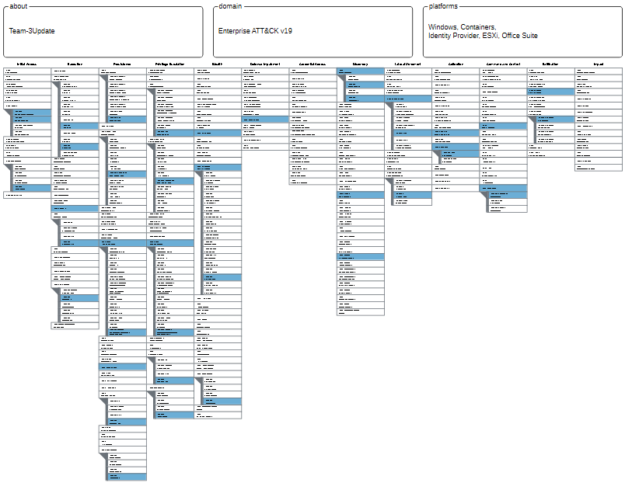
MITRE ATT&CK

Slide 5
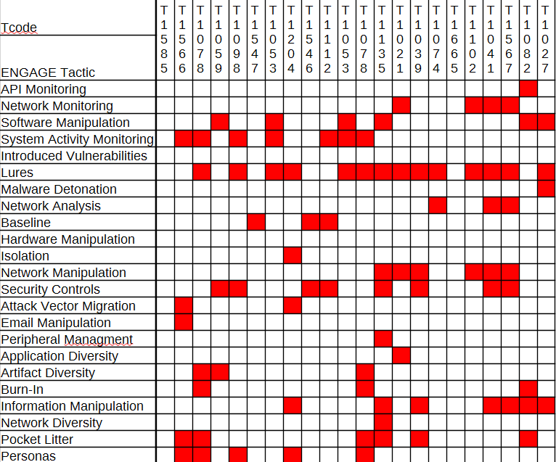
MITRE ENGAGE
The Grid below shows the related Engage categories effected.

Slide 6
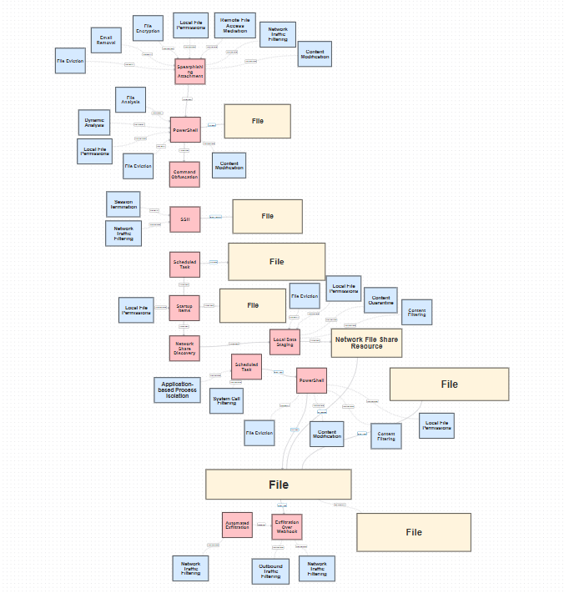
D3FND CAD

Slide 7
COA’s
COA 1: (Recommended) Information Manipulation ID: EAC0015;
  Modify the Autorun Powershell to upload false staged data instead of the valid staged data to the rocket chat API.
COA 2: Security Controls ID: EAC0018;
  Update Powershell Execution Policy disabling non-approved autoruns from local machines, also possible by utilizing Windows Defender Application Control.

Slide 8
Questions

